Slide 1
TEMPLATE
Change Management Communication Plan

Slide 2
Introduction
A change management communication plan serves as a structured roadmap for HR professionals to outline and highlight the key activities necessary to successfully implement and manage change within an organization. The communication plan focuses on critical areas such as determining change impact, communication, stakeholder engagement, training, sponsorship, and measurement.
A core function of this communication plan is to create awareness of critical change activities with stakeholders, ensuring that they are well informed, engaged, and aligned with the change process. By outlining clear activities, assigning responsibilities, and setting timelines, the communication plan helps HR professionals keep all stakeholders updated on progress, address their concerns, and secure their support throughout the change journey. This ensures a smooth transition and increases the likelihood of successful outcomes.

Slide 3
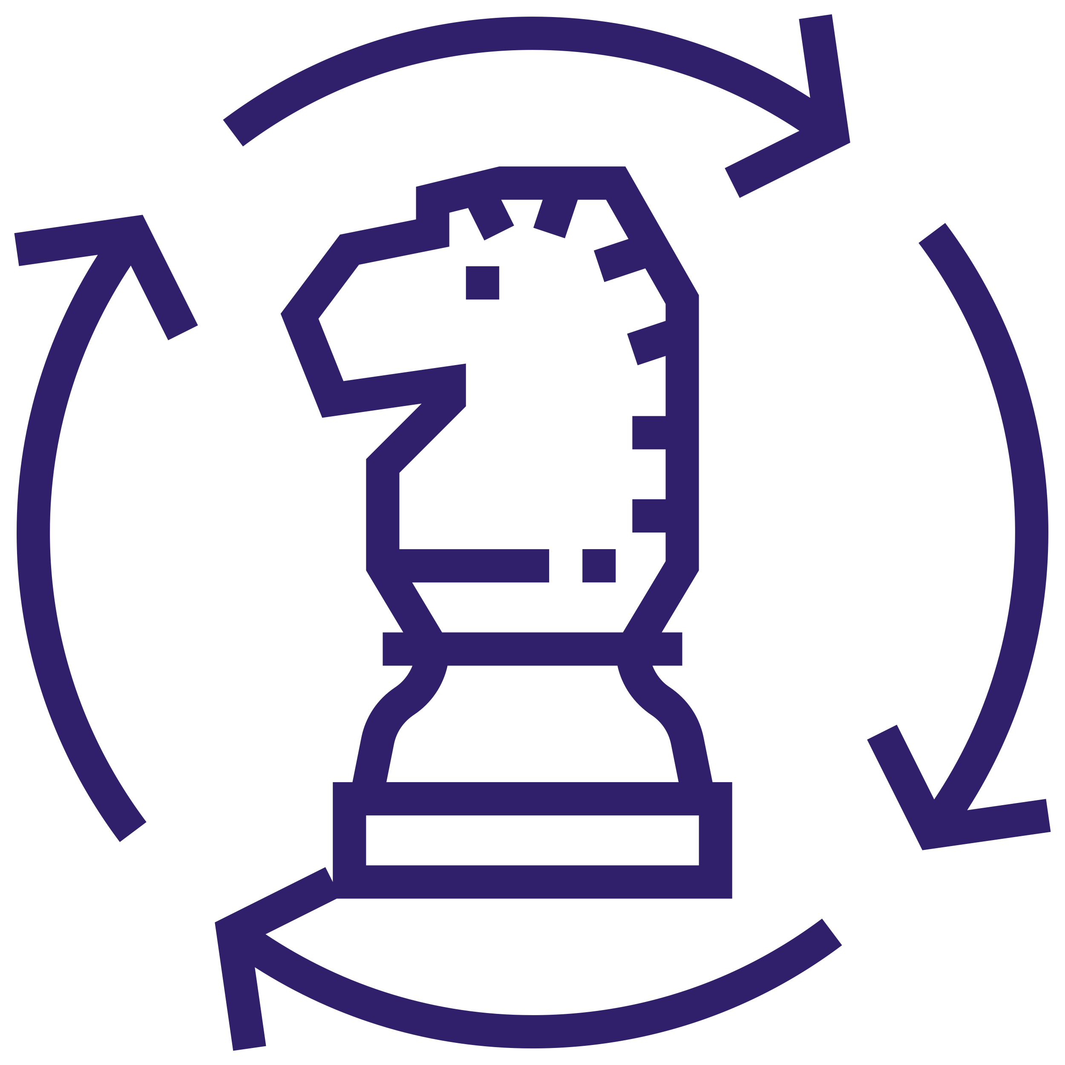





Key Activity Areas
This communication plan is organized into several key activity areas, each critical to the success of a change management initiative. Here's a breakdown of these key activity areas.
Change approach and impact
Focus on defining the overall strategy for the change and determining how it will impact roles, KPIs, and the organization. This area ensures that the change is aligned with business goals and performance metrics.
General communication
Ensure that all stakeholders are informed and engaged throughout the change process via timely and effective communication. It covers the dissemination of key messages, updates, and successes to build awareness and support.
Leadership engagement
and sponsorship
Engage leadership to drive and endorse the change while aligning the organizational culture with the new direction. This area emphasizes the role of leaders in influencing and sustaining change.
Measurement
Track the progress and effectiveness of the change initiative, allowing for adjustments as needed. This area ensures that the impact of the change is measured, and lessons are learned for future initiatives.
Training
Provide the necessary training and resources to equip employees with the skills and knowledge required for the new environment. This area ensures that staff are prepared and supported throughout the transition.
Support
Offer ongoing assistance to sustain the change, addressing any issues that arise postimplementation. It includes mechanisms for governance, continuous learning, and personalized support to ensure the change sticks.

Slide 4
Use the templates on pages six and seven to ensure a smooth and well-communicated change initiative within your organization. Use the existing activities in each key area as a starting point and customize them by adding or removing tasks to fit your specific change management plan. Be sure to adjust the timeline and measurement points as needed.
Change Management Communication Plan // Template example
 |  | 2024 |  |  |  | 2025
 |  | Sept | Oct | Nov | Dec | Jan | Feb | Mar | Apr | May
1 | Change approach and impact
2 | Leadership engagement and sponsorship
3 | Training
4 | General commu- nication
5 | Support
Confirm strategy/
communi-
cation plan
Confirm role impact and KPI
Incorp-orate into KPI
Development of role-based test cases
Lessons learned
Launch
Needs analysis
Governance and decision-making
Culture impact
Leader-led conversations
Leadership community engagement
Onboard people in new roles
Sponsor support
Confirm training approach
Identify super users
Training positioning
Training execution
User support
Embed operational governance
Development of materials
Launch comms
Case for change
Role/KPI impact
Sharing success
Support comms
Sharing success
Quick win
User Acceptance Training (UAT) communication
Handholding
Knowledge transfer
Set up help desk
Measurement

Slide 5
Here is a guide to using this template.
Change Management Communication Plan // Template guide
Key activity areas
Timelines
 |  | 2024 |  |  |  | 2025
 |  | Sept | Oct | Nov | Dec | Jan | Feb | Mar | Apr | May
1 | Change approach and impact
2 | Leadership engagement and sponsorship
3 | Training
4 | General communica-tion
5 | Support
Confirm strategy/
comms plan
Confirm role impact and KPI
Incorp-orate into KPI
Development of role-based test cases
Lessons learned
Activities and when they happen
Launch
Needs analysis
Governance and decision-making
Culture impact
Leader-led conversations
Leadership community engagement
Onboard people in new roles
Sponsor support
Confirm training approach
Identify super users
Training positioning
Training execution
User support
Embed operational governance
Development of materials
Launch comms
Case for change
Role/KPI impact
Sharing success
Support comms
Sharing success
Quick win
User acceptance training (UAT) communication
Handholding
Knowledge transfer
Set up help desk
Measurement
Points of measurement

Slide 6
Change Management Communication Plan
[Project name]
CHANGE PROJECT OVERVIEW
Project manager | [Enter here]
Date of initiation | [Enter here]
Expected completion date | [Enter here]
Sponsor | [Enter here]
Budget | [Enter here]
Project goals and objectives
Specific outcomes are expected from the change.
Definition of success
A brief description of the success criteria emphasizes the successful implementation of the project For example, the HR tech system has been fully implemented, achieving 90% user adoption and maintaining 95% uptime.

Slide 7
 |  | [Year] |  |  |  | [Year]
 |  | Sept | Oct | Nov | Dec | Jan | Feb | Mar | Apr | May
1 | [Enter here]
2 | [Enter here]
3 | [Enter here]
4 | [Enter here]
5 | [Enter here]
Measurement

